Slide 1
What is government?
The main purpose of the Government is to govern, manage and protect the individual rights for its citizens. It ensures the proper use of force by specifying laws, to clarify the use of force. The government is also responsible for enforcing laws.

Slide 2
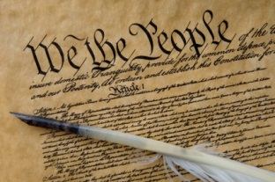
Federalists
Federalists are pro constitution and like a strong central government. A famous Federalist is Alexander Hamilton

Slide 3
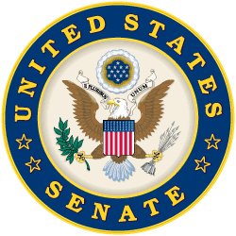
Anti Feds
Thomas Jefferson was afraid of a strong central Gov and wanted a more powerful state governments!

Slide 4
Democratic Theory
The traditional Democratic theory is based upon the principles of equality in voting, effective participation, enlightened understanding, control of the agenda by citizens, and inclusion. Inclusion means that the government must include and extend rights to all those that are subject to its laws. These are the five criteria that the Democratic theorist Robert Dahl listed as being necessary for an ideal democratic process.

Slide 5
Republicanism
Republicanism is the ideology of governing a society or state as a republic (la. res publica), where the head of state is a representative of the people who hold popular sovereignty rather than the people being subjects of the head of state. The head of state is typically appointed by means other than heredity, often through elections.

Slide 6
Pluralism
Pluralism is the theory that states that a multitude of groups and not the people as a whole govern the country. These organisations influence the making and administration of policies and laws. The participants in the process constitute only a small fraction of the populace, thus the public acts mainly as bystanders.

Slide 7
Elitist theory
An elitist theory of government is a theory that describes the power relationships within a society. The theory maintains that a very small group of the elite hold the most power within a government body.

Slide 8
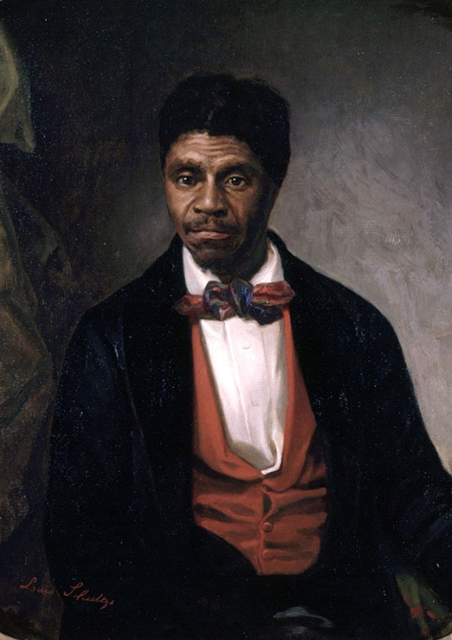
Gibbons v. Ogden
Fought over if congress supersedes a state law. It does. State is weaker then the Fed.
Steam boat rights in New york!

Slide 9
Marbury v. Madison
attempt by the Federalists to take control of the federal judiciary before Thomas Jefferson took office.

Slide 10
McCulloch v. Maryland
The Court invoked the necessary-and-proper clause in the Constitution, which allowed the Federal government to pass laws not expressly provided for in the Constitution's list of express powers as long as those laws are in useful furtherance of the express powers.
that the Constitution grants to Congress implied powers for implementing the Constitution's express powers, in order to create a functional national government, and that state action may not impede valid constitutional exercises of power by the Federal government.

Slide 11
State vs. Fed Government.
States control some aspects of govenrment but the Government is the top dog and sometimes their policies differ and create problems. They control different but sometimes the same things.

